Slide 1
Assignment 1
Target : Prediction of Boston Housing Price using Linear Regression
Dataset Source: https://archive.ics.uci.edu/ml/machine-learning-databases/housing/
Kernel: https://www.kaggle.com/sagarnildass/predicting-boston-house-prices

Slide 2
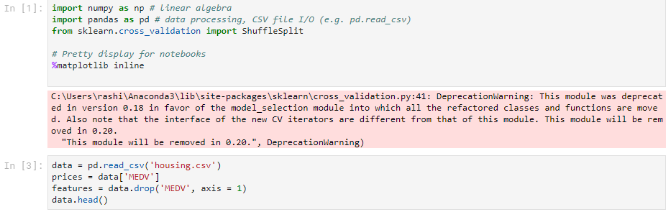
Loading the Dataset

Slide 3
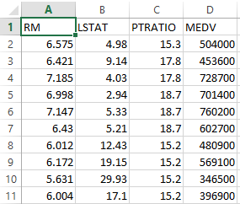
Preprocessing the Dataset
There are 13 features in the Boston housing dataset and among them RM,LSTAT and PTRATIO features are selected for the regression for their correlation with MEDV.
RM - average number of rooms per dwelling
LSTAT - % lower status of the population
PTRATIO - pupil-teacher ratio by town
MEDV - Median value of owner-occupied homes in $1000's

Slide 4
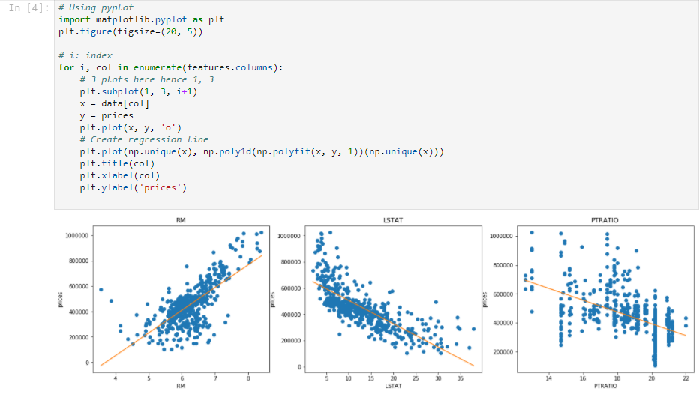
Data Exploration

Slide 5
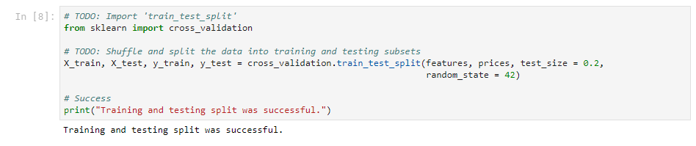
Implementation: Shuffle and Split Data

Slide 6
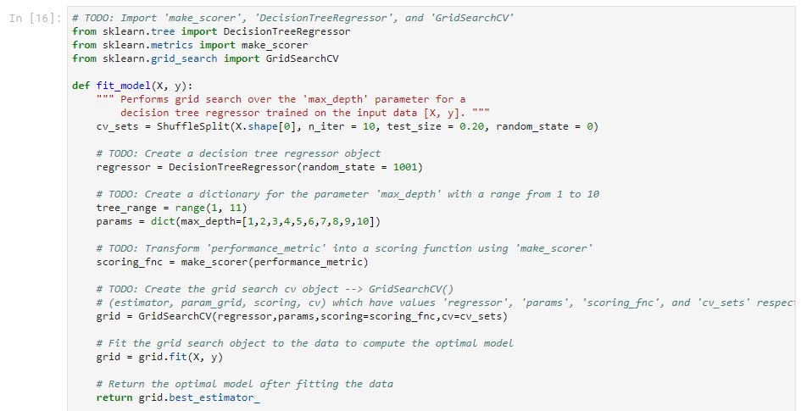
Implementation: Fitting a Model

Slide 7
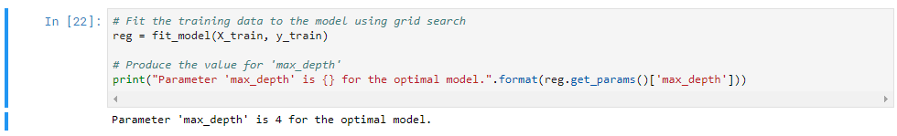
Implementation: Fitting a Model

Slide 8
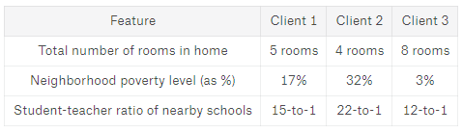
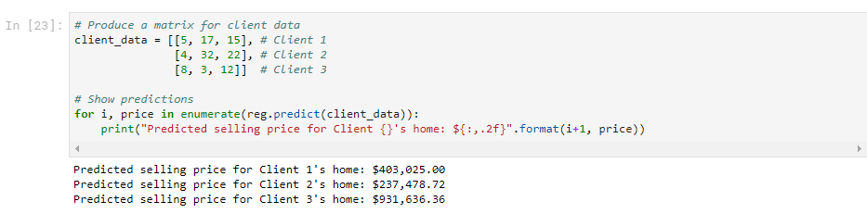
Predicting Selling Prices

